Slide 1
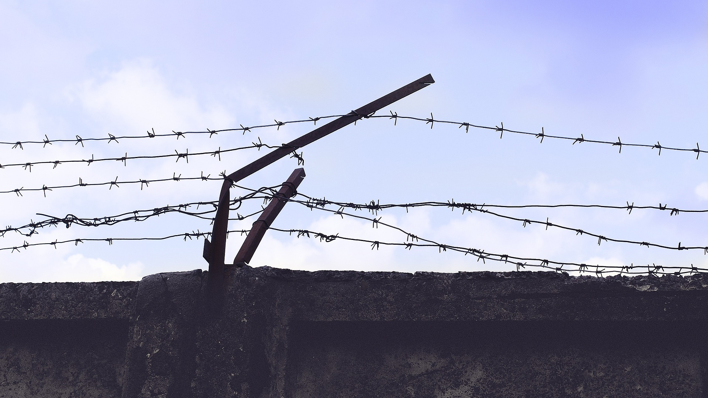
BYPASS SURGERY
BQ2 Values Lesson 5
I can explain the role of the arts in helping us to understand ethical issues
Notes:
See how this lesson links to the course by viewing the final slide
Key TOK terms appear in a red font

Slide 2
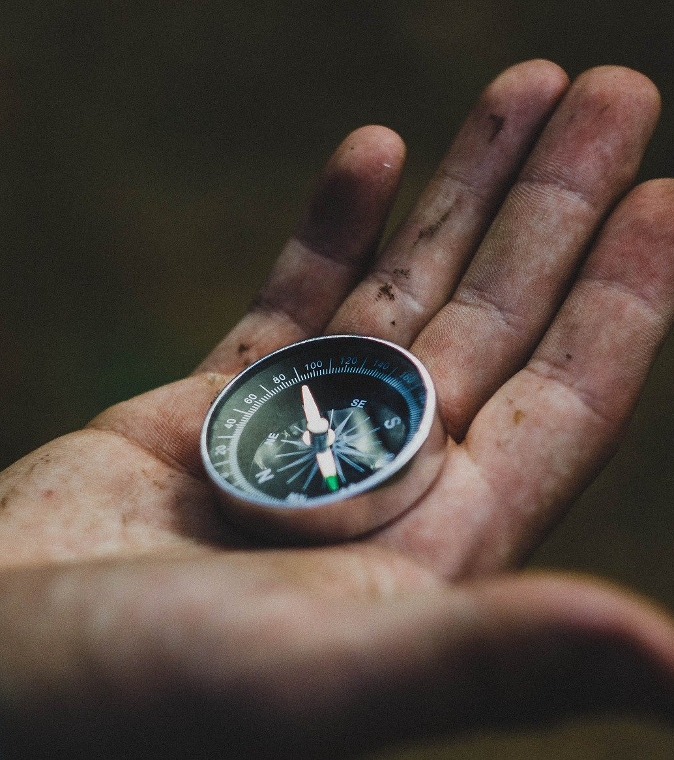
Starter
What did we say in the last lesson were the key influences shaping the way we morally navigate the world?

Slide 3
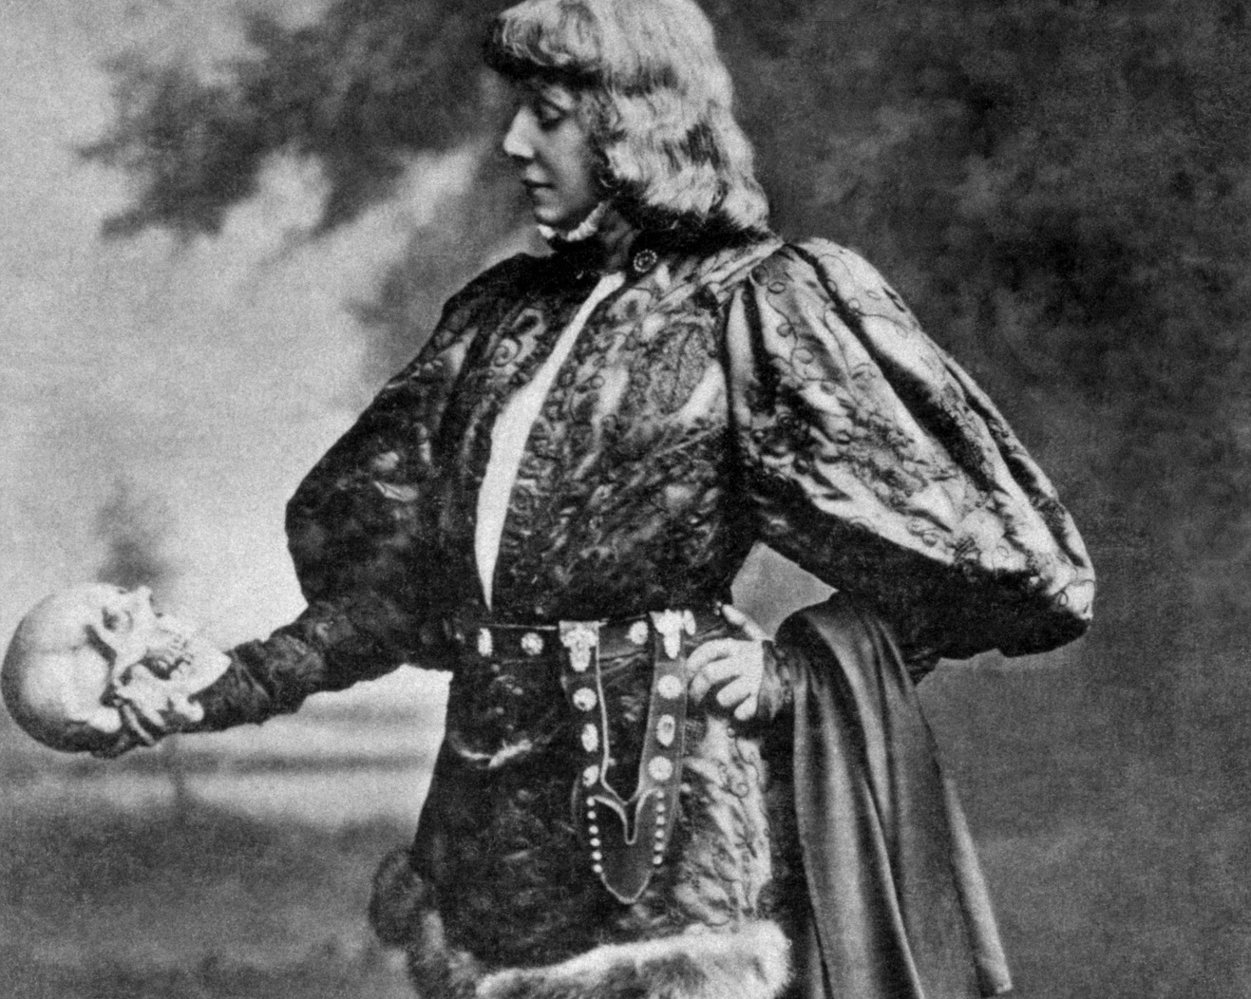
Pair, share
What role do the arts play shaping our ethical awareness?
Think of some examples to support your answer - films, music, literature, visual art, poetry, theatre, etc., etc.
Notes:
Debrief. It’s almost more difficult to find films and books (etc.) that don’t deal with moral issues. Image shows a production of Hamlet, starring Sarah Bernhardt. All of Shakespeare’s plays deal with moral issues.

Slide 4
Investigating racial inequality in the US & UK
Read through the information in the handout
How does this make you feel in terms of the issues of equality and racism?
Notes:
See this link for student handout 1: statistical data on inequality and racism; adapt for your country/region if necessary.
The statistics should make students feel bad - but perhaps there’s nothing surprising or remarkable about these figures. Does it get them on a ‘gut level’? Does it shock them?

Slide 5
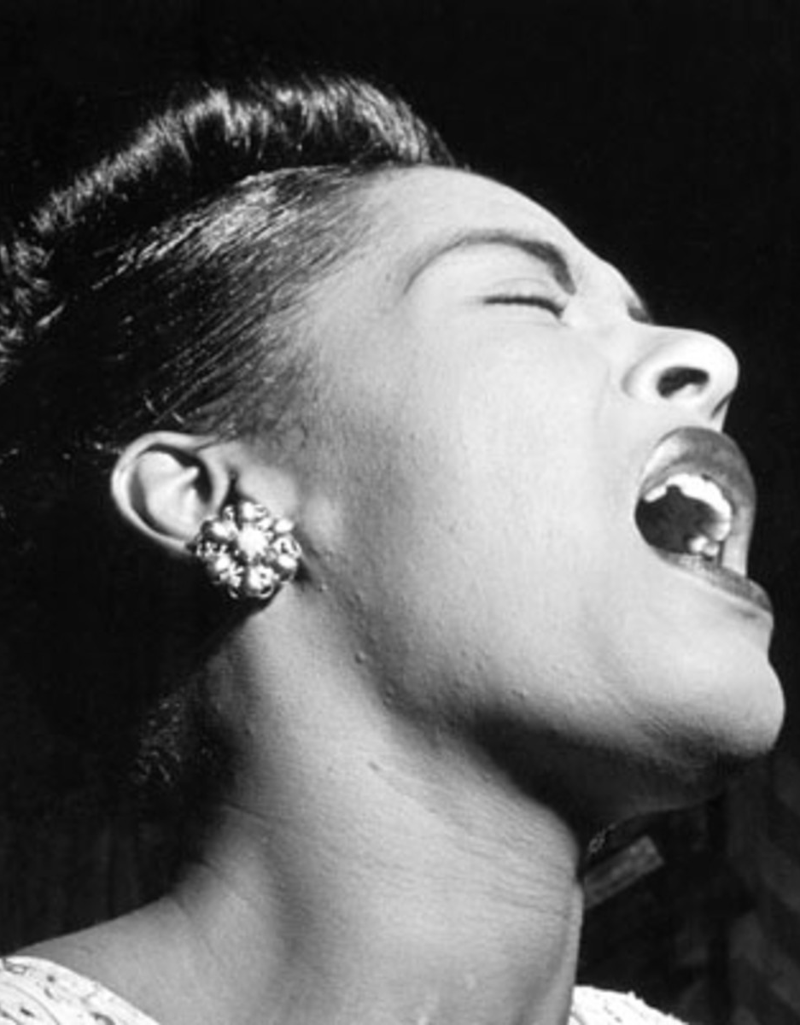
Breakout groups
Read the background notes to each artistic link.
In your groups, listen/read/watch at least three of the sources.
Answer the questions on the handout about the sources you’ve looked at.
Find out from another group about at least one more of the sources.
Notes:
Links to the artistic sources. Post on Google Classroom.
Link 1 To Kill a Mockingbird
Link 2 Strange Fruit (lyrics are found easily on Google)
Link 3 Barca nostra
Link 4 Dave Chappelle stand up
Link 5 The Merchant of Venice

Slide 6
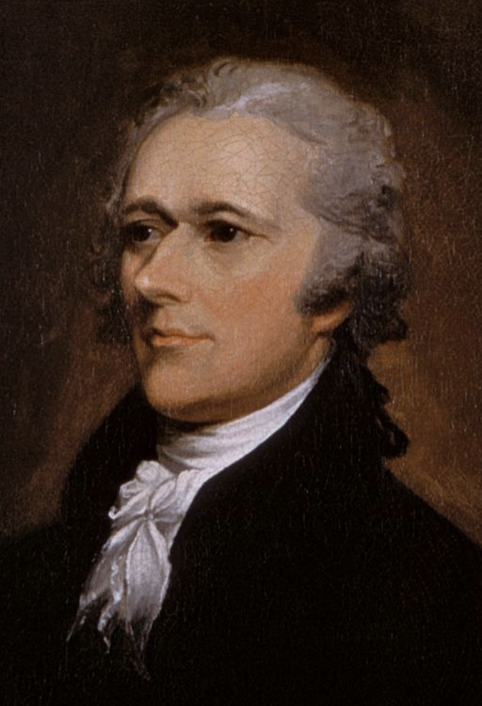
Making sense of this
Lin-Manuel Miranda on art:
“What artists can do is bring stories to the table.”
What do you think he meant?
Check out the article in which he says this, to check your interpretation.
What example does he say about the way art gives us the ‘real’ picture?
How does this relate to what we’ve done in this lesson?
Notes:
Quote in full: “What artists can do is bring stories to the table that are unshakably true—the sort of stories that, once you’ve heard them, won’t let you return to what you thought before” (see article here).
Miranda also refers to a picture taken of a family of immigrants trying to get into the US. The picture showed the daughter separated from her mother, and clearly in distress. The picture was misinterpreted as being about a family forcibly separated; it was actually just the mother reaching for her papers. But Miranda says the details don’t matter: we should empathise with all humans in this situation - this is the ‘real’ picture - and art (in this case, photography) can provide us with this.
This fits in with what we’ve done today - art is about engaging our emotions, not providing us with statistical details.
Students may disagree - maybe the details do matter...

Slide 7
Links to the TOK exhibition
Related exhibition prompt What role does imagination play in producing knowledge about the world (IAP-30)?
Refer to the ideas from this lesson to answer this question.
For example, how do the arts help catalyze our understanding of moral issues via a stimulation of the imagination?
Think about objects which might help to illustrate your answer.
Notes:
Optional slide, if you want to help students to take ownership of the IA prompts (IAPs) for the TOK exhibition
Note that the IB recommends using the core and/or optional themes as the context of the exhibition commentary, whereas this lesson deals more with areas of knowledge (the arts)

Slide 8
“I believe great art is like bypass surgery. It allows us to go around all of the psychological distancing mechanisms that turn people cold to the most vulnerable among us.”
Do you agree with Lin-Manuel Miranda?
Notes:
See the BQ2 assessment tracker for suggestions on providing feedback, and recording students’ progress

Slide 9
Linking this lesson to the course
During this lesson, we consider the highlighted aspects of the TOK course
The images used in the presentation slides can also give students ideas about selecting exhibition objects; see also our link below to a specific IA prompt
CORE THEME | OPTIONAL THEMES | AREAS OF KNOWLEDGE | TOK ASSESSMENT
Knowledge & the knower | Indigenous societies | The arts | The TOK essay
 | Language | History
 | Politics | The human sciences | The TOK exhibition Could be linked to IAP-2 (types), IAP-30 (imagination), IAP-34 (values)
 | Religion | Mathematics
 | Technology | The natural sciences

Slide 10
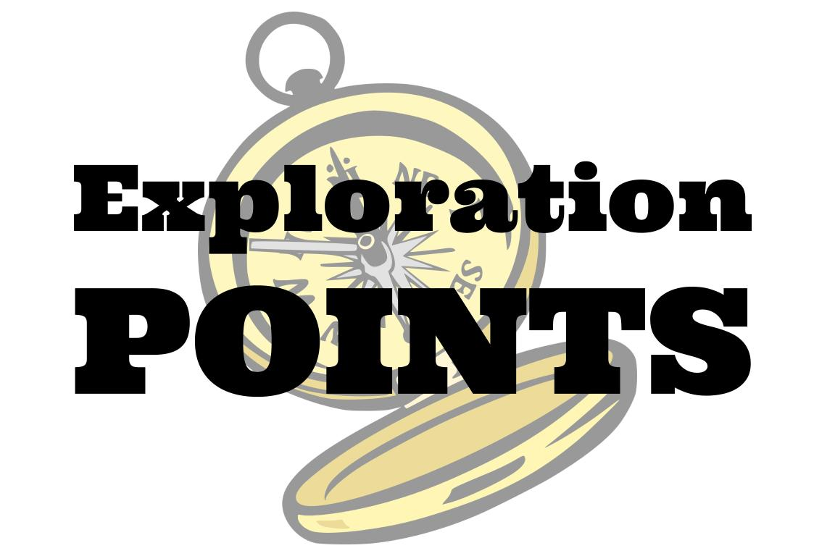
Explore the TOK themes and areas of knowledge in more depth via a range of thinkers, media sources, and other resources, in our EXPLORATION POINTS DOCUMENTS.
Access the documents via the links below. You’ll also find the EP icons on all of the TOK course pages of the site to help you unpack the quotes, KQs, and real-life situations that you find there.
CORE THEME
Knowledge & the knower
OPTIONAL THEMES
Indigenous societies
Language
Politics
Religion
Technology
AREAS OF KNOWLEDGE
The arts
History
Human sciences
Mathematics
Natural sciences
Notes:
Use this slide to access the ‘Exploration Points’ notes for BQ2, which will help students to develop a deeper knowledge of any TOK theme or area of knowledge. This will not only help them to master the TOK course in general, but also craft a great exhibition or essay.
Be ready to provide more guidance on how to use this resource - ie, which media sources to focus on, which questions to address, which TED talks to watch, and which key terms and ideas to understand.

